Slide 1
1. Invent Yourself
František Kundracik
Department of Experimental Physics
Faculty of Mathematics, Physics and Informatics
Comenius University, Bratislava, Slovakia

Slide 2
1. Invent Yourself
Design a boat that moves only due to the periodical mechanical movements of its internal parts and which only interacts with the environment (air, water) through its stiff hull. Optimise the parameters of your boat for maximum speed.

Slide 3
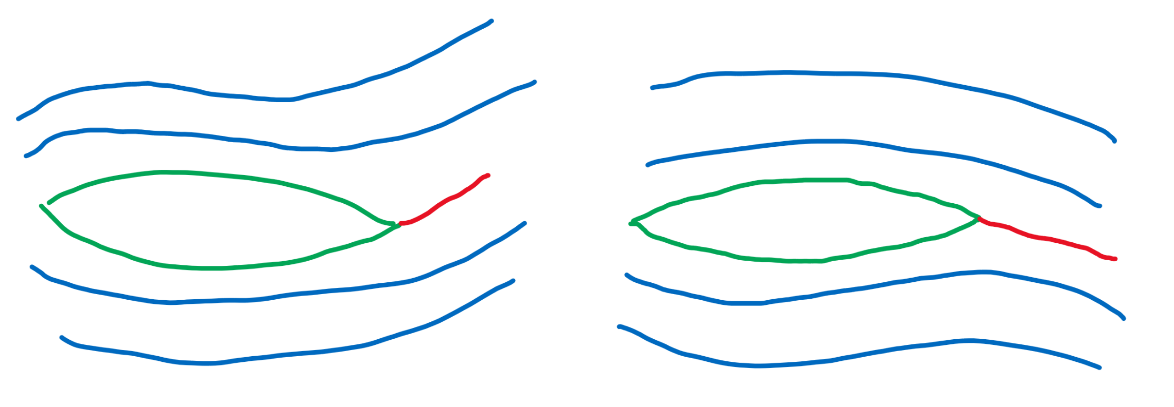
Stiff hull only – no rudder
Fish-like motion

Slide 4
Stiff hull only – no flaps
Backward motion is supressed

Slide 5
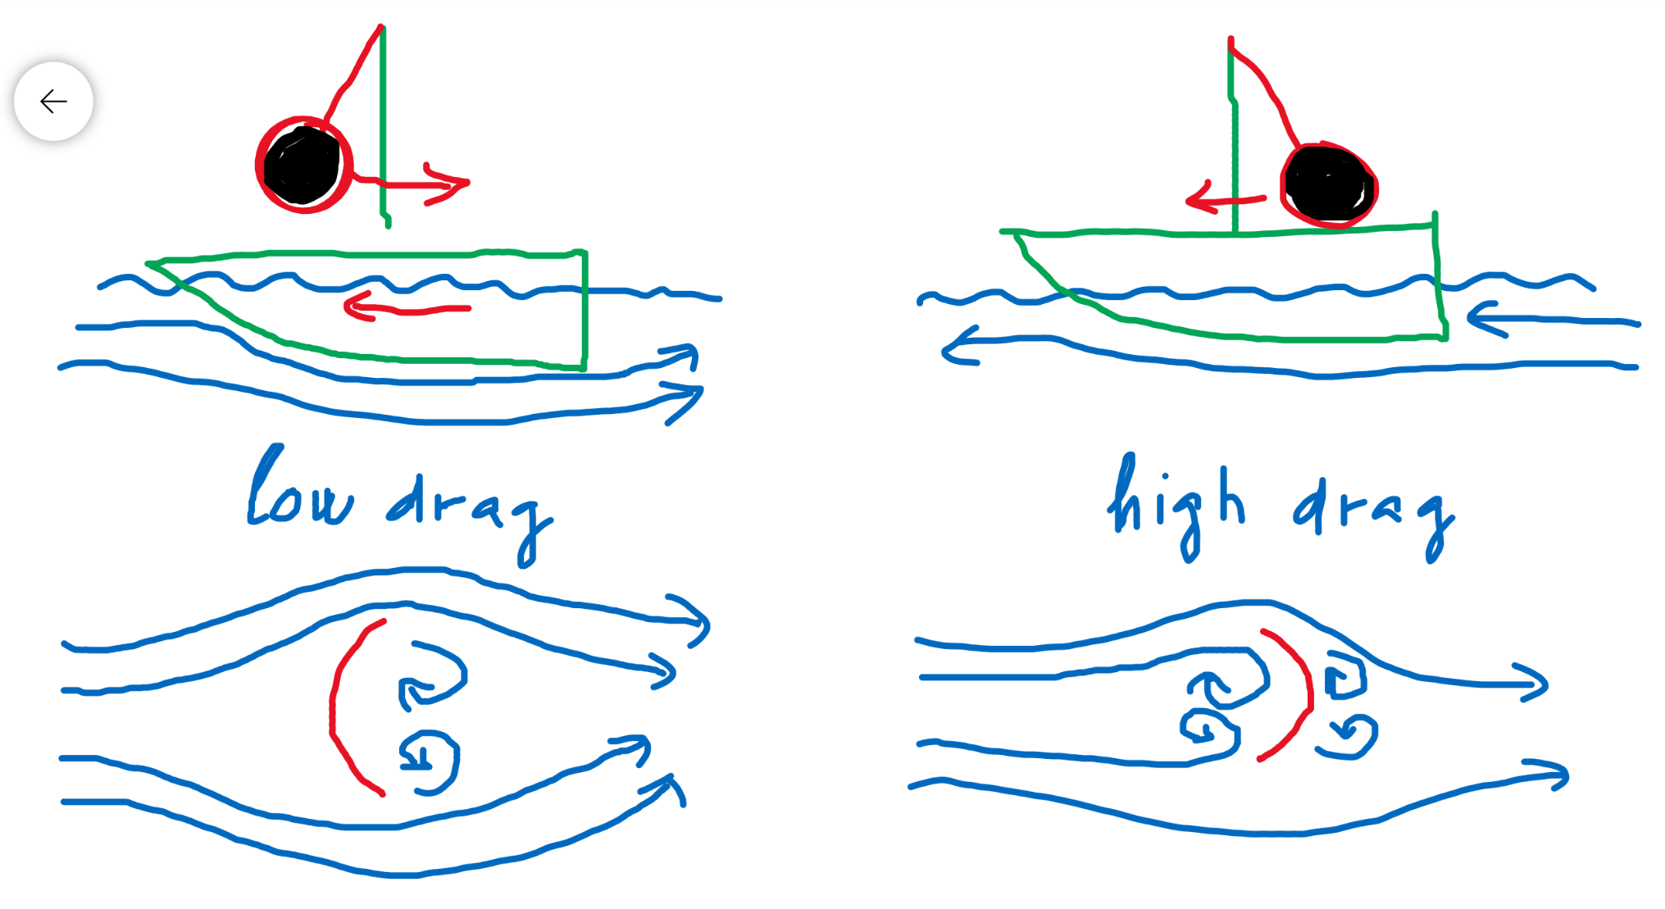
Stiff hull only – asymmetry is allowed
Backward motion is supressed

Slide 6
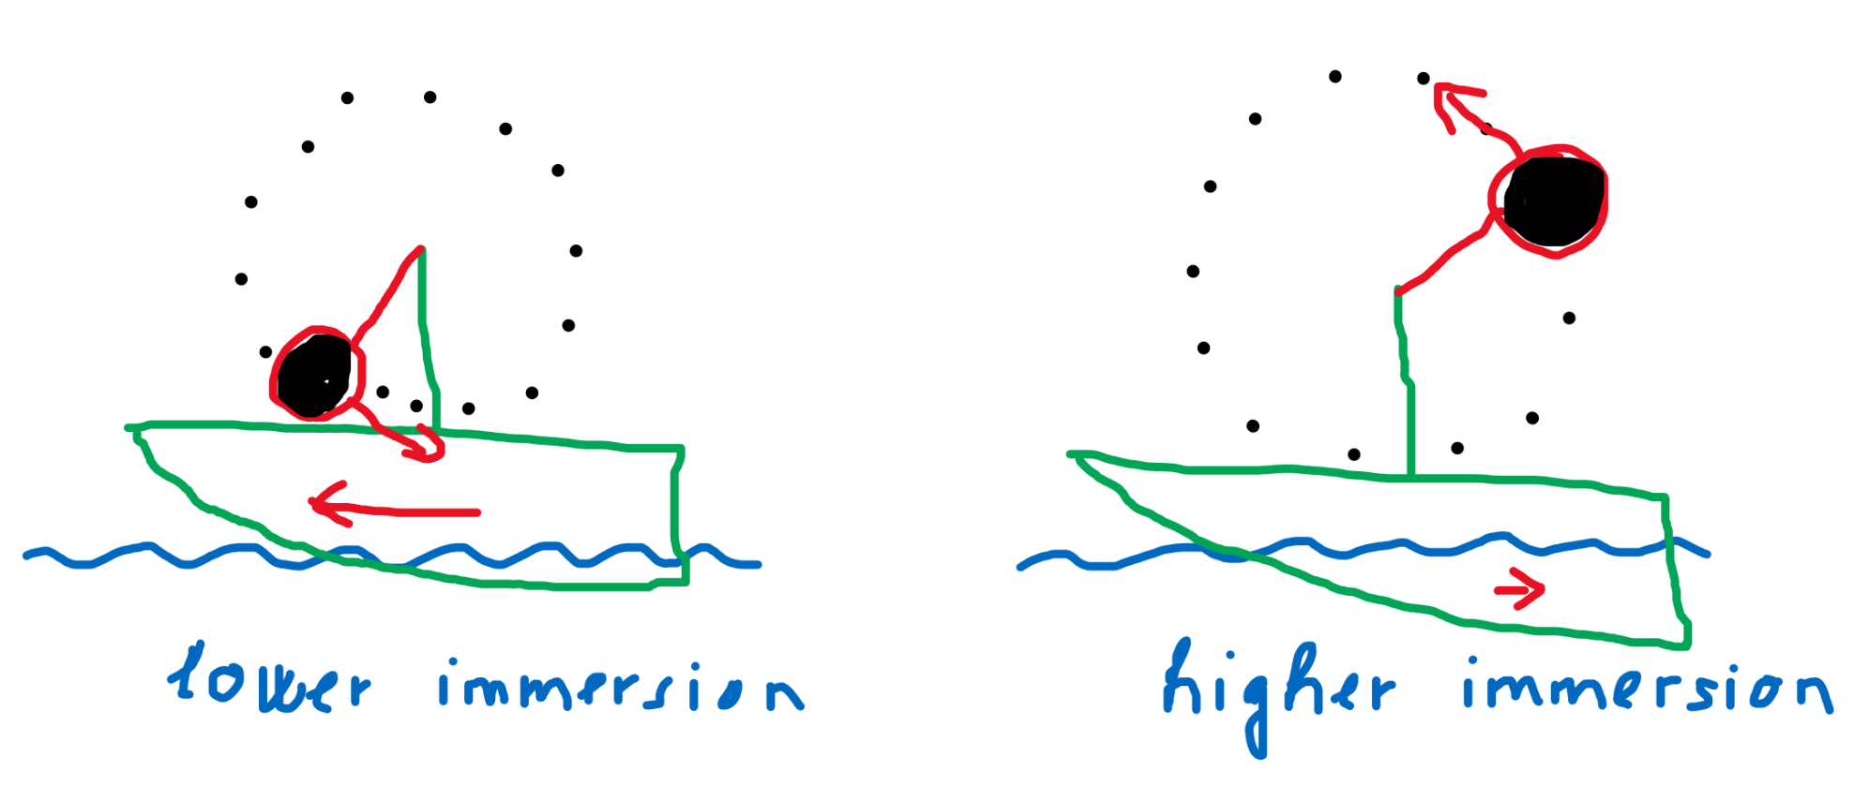
Stiff hull only – asymmetry is allowed
Even better – circular motion – immersion depth is changing

Slide 7
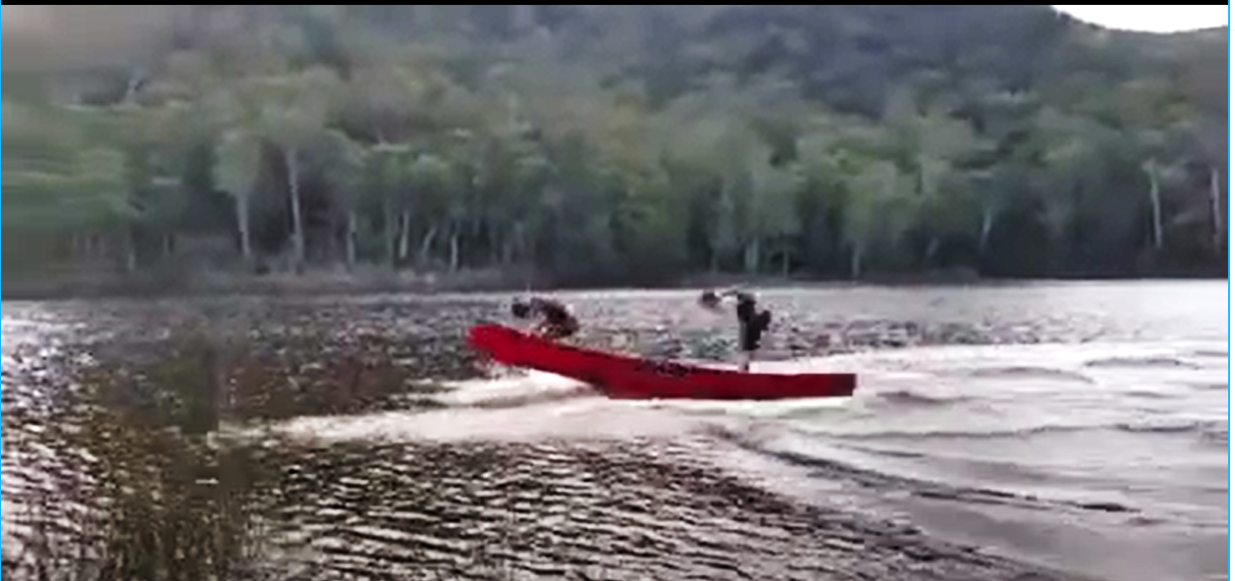
Motivation
Video of a moving canoe without paddles
https://www.youtube.com/watch?v=jlvmQzoossI&feature=youtu.be

Slide 8
Motivation
Two main phases:

Slide 9
What to do with the task
Build and optimize scaled-down model based on the motivation video
Try to invent your own design (another principle)

Slide 10
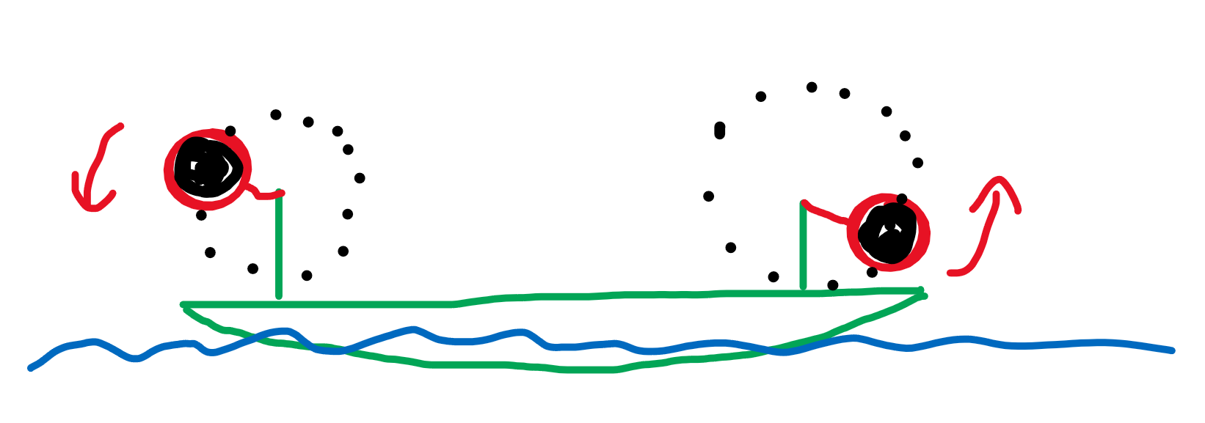
Optimizing the model based on the motivation video
Vertical oscillations can be changed to synchronized circular motion of weights
Parameters: mass, radius, frequency, they can change
Depth of immersion
Frequency of wobbling

Slide 11
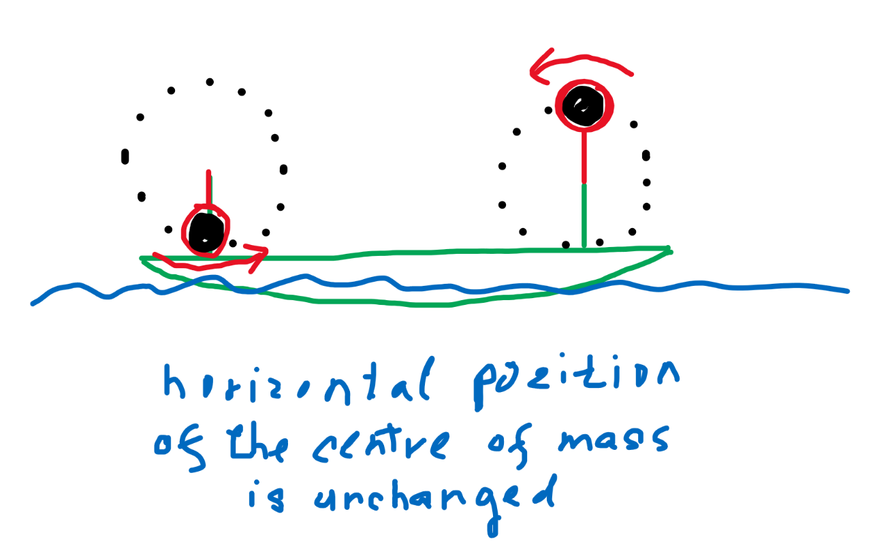
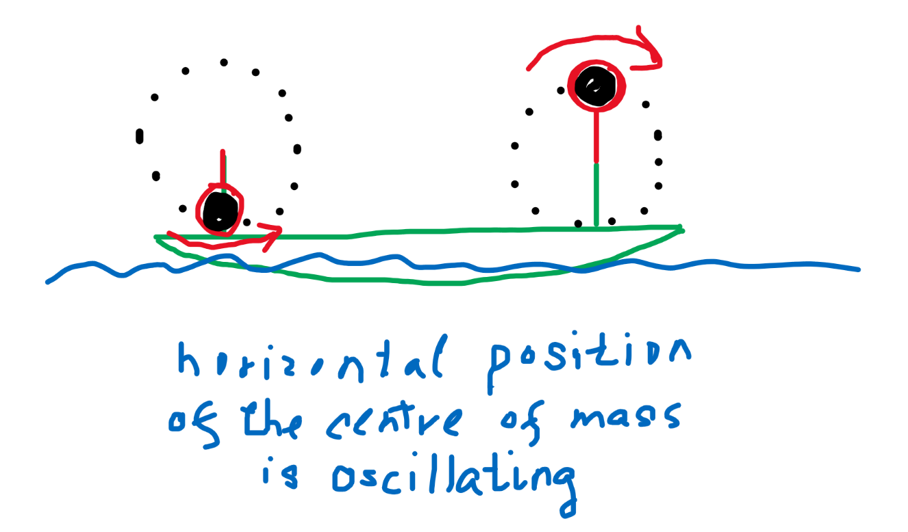
Model based on the motivation video
Parameter: the same/opposite direction of rotation
Horizontal oscillations are canceled/amplified
Parameter: phase shift between the weights
Water flow can be influenced

Slide 12
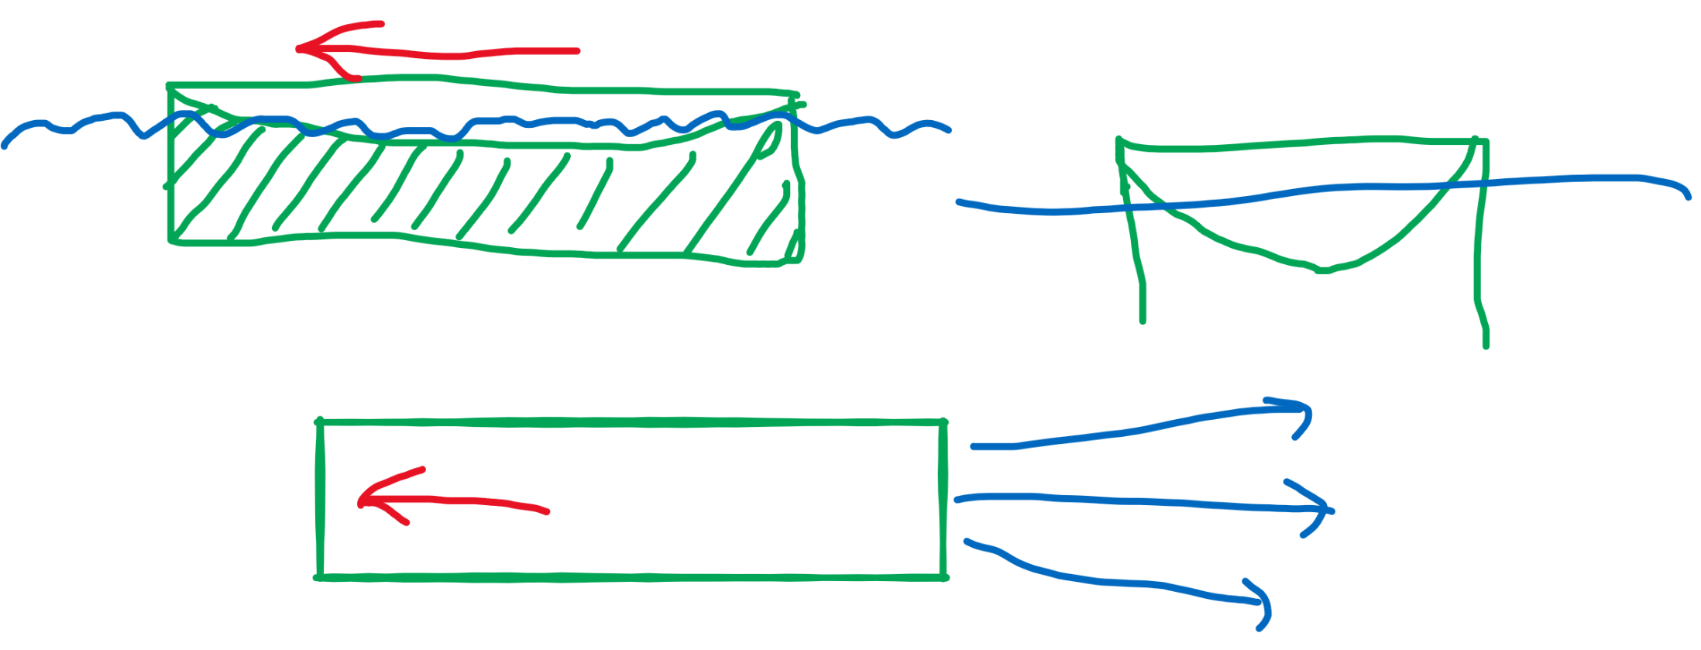
Model based on the motivation video
Optimizing the shape of the boat
Side-stops can prevent the off-axis flow of the water

Slide 13
Model based on the motivation video
Optimizing the frequency
Interaction boat-waves is influenced
Gravity waves on the water
The main force returning the water level to equilibrium is gravity
Consult Wikipedia and references therein for more information

Slide 14
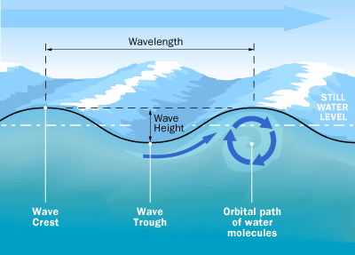
Gravity waves on water
Phase velocity:
g – gravitational acceleration
λ – wavelength, k=2π/λ
Wavelength vs. Frequency
$$c_{ph}=\sqrt{\frac{g}{k}}=\sqrt{\frac{gλ}{2π}}$$
$$c_{ph}=\frac{ω}{k}$$
$$λ=\frac{2πg}{ω^{2}}$$

Slide 15
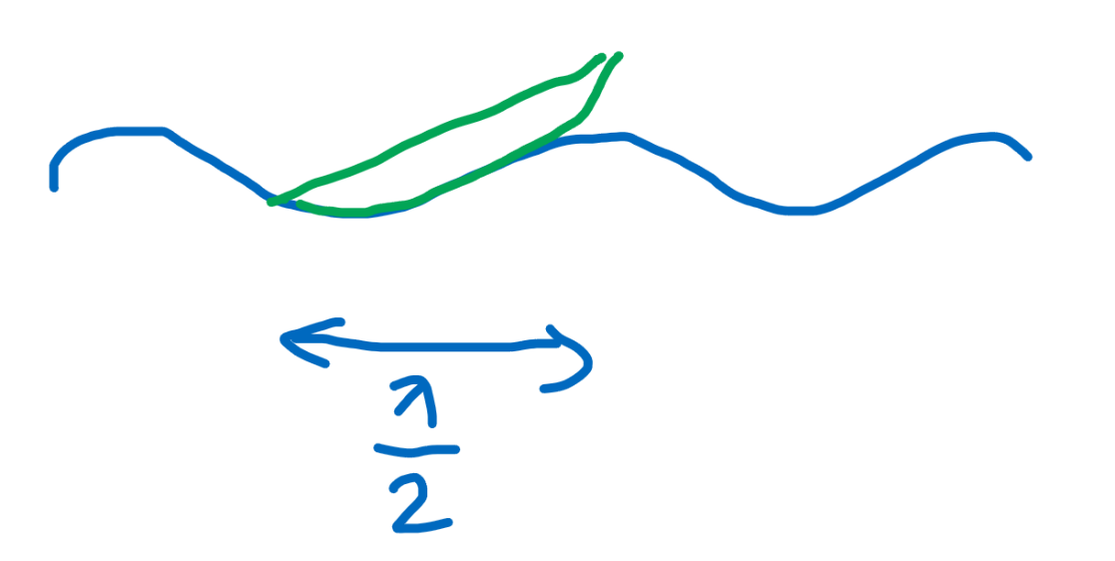
Optimizing the shape of the boat
Wavelength of the waves produced by a boat oscillating with angular frequency ω is:
What happens if the wavelenth is comparable with the length of the boat?
Faster motion?
Slower motion?
$$λ=\frac{2πg}{ω^{2}}$$

Slide 16
Finding your own design
Try to find another principles
Don forget, that boat „interacts with the environment (air, water) through its stiff hull. “
Whole mechanism should be hidden in the boat, otherwise the oponent can argue that the boat is moving due to interaction of your mechanism with the air
Thanks for your attention!

